Slide 1
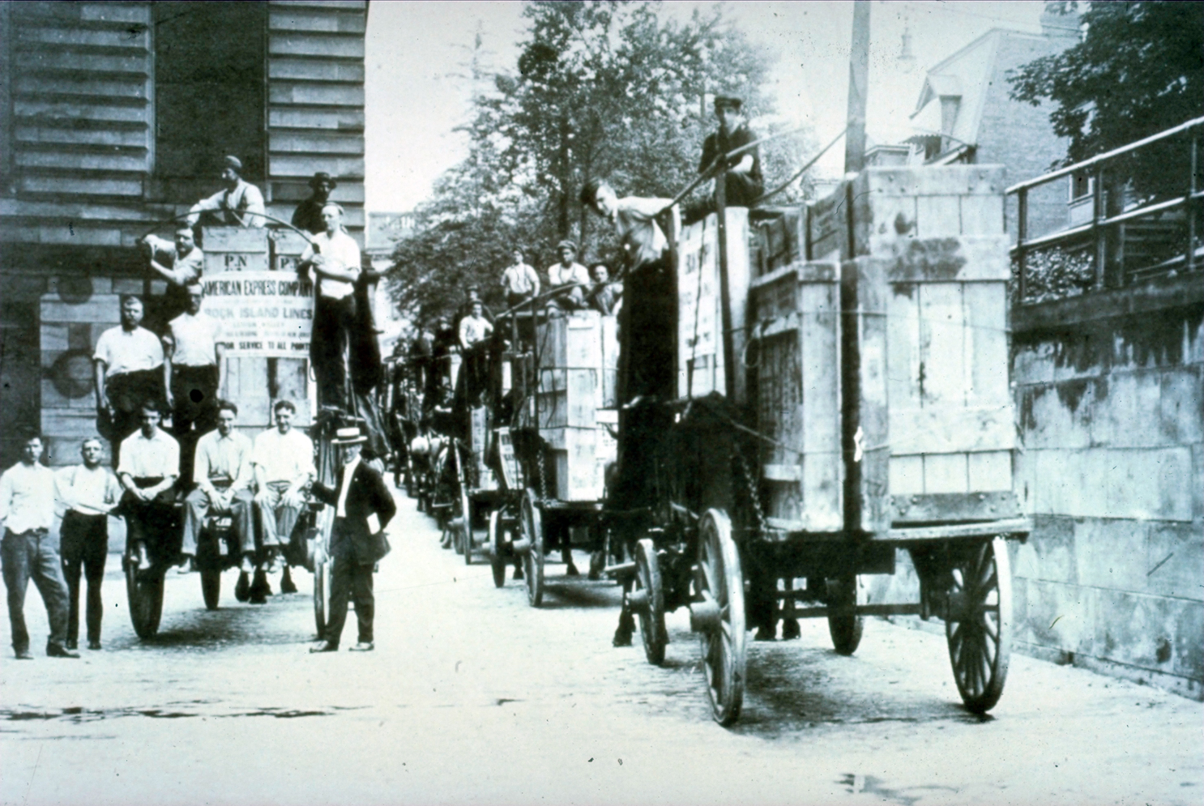
Welcome to CMOA’s 2016 Digital Provenance Symposium

Slide 2
Introduction to Art Tracks
What is provenance?
Why bother?
What can you do with it?
Quill pens and keyboards

Slide 3
Provenance is…
A chain of ownership or possession of a work of art
A list of names and places in chronological order
An obsession

Slide 4
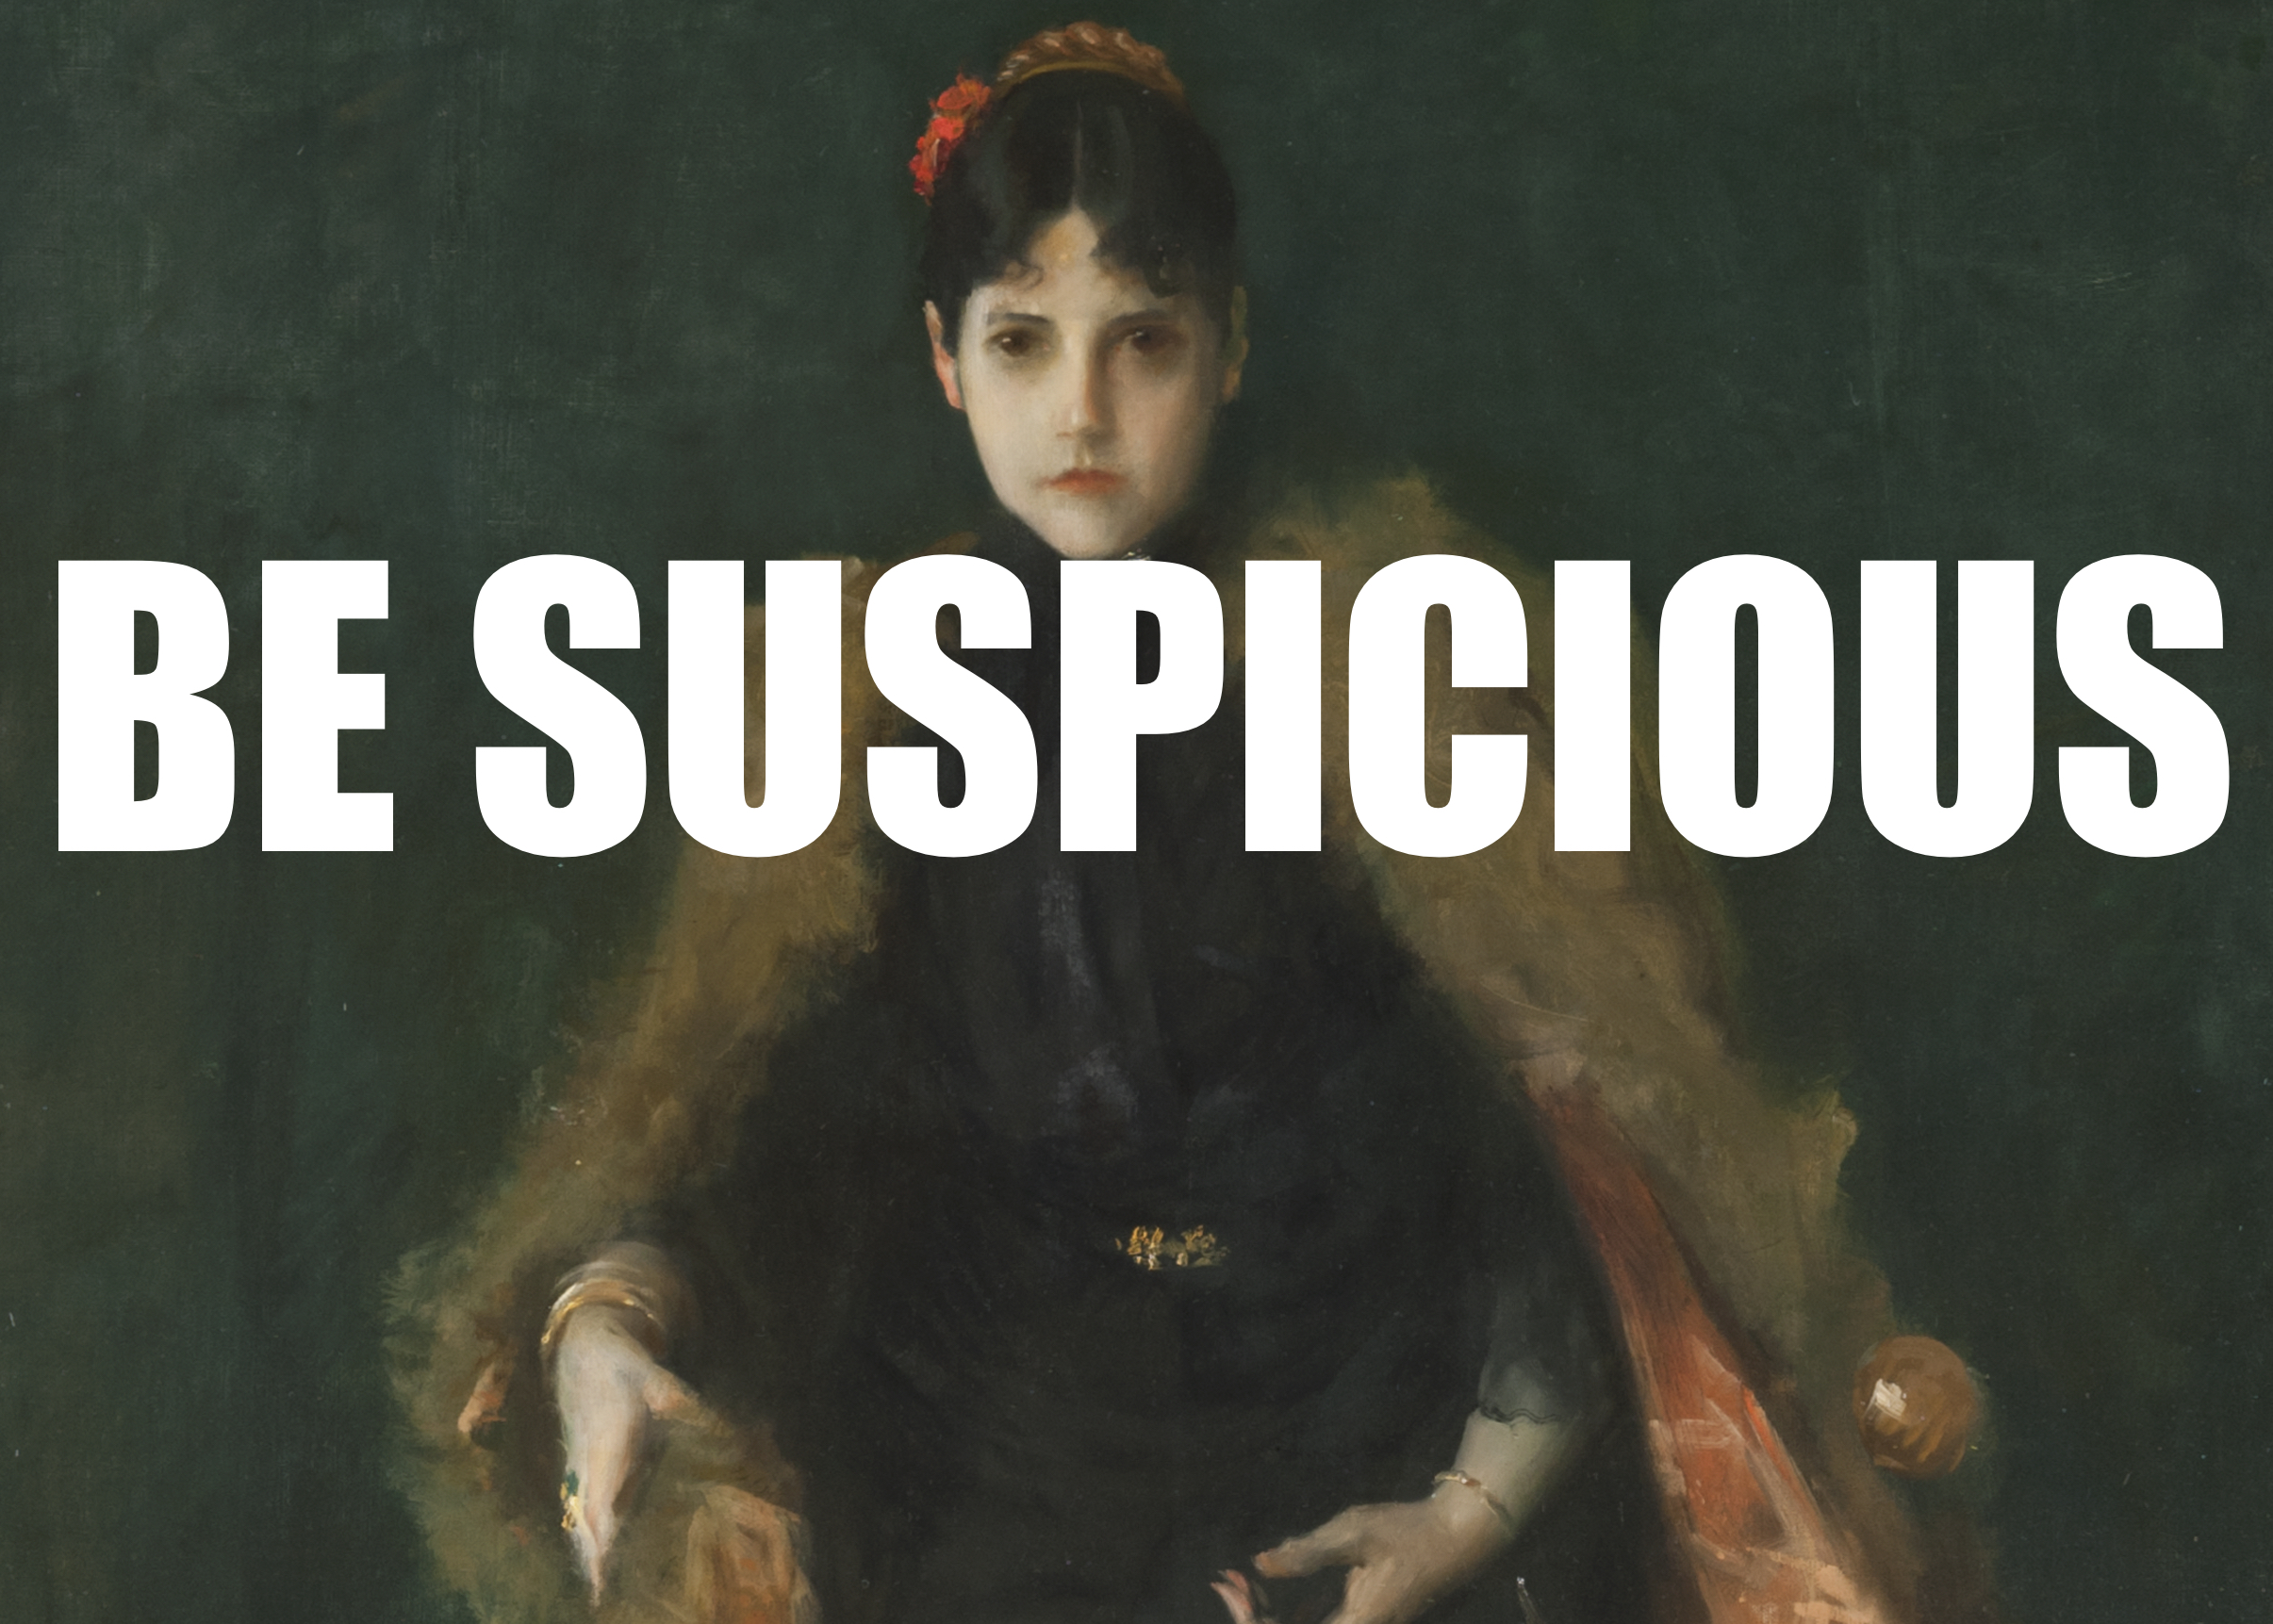
Provenance: how do you do it?
Object analysis
iconography, function, age, materials, place of origin, inscriptions, labels, previous restorations, framing
Event records
exhibitions, transactions, direct copies
References
reproductions, photos, publications
Biography
wills, inventories, lawsuits, genealogies, business records, banking records, gossip columns

Slide 5
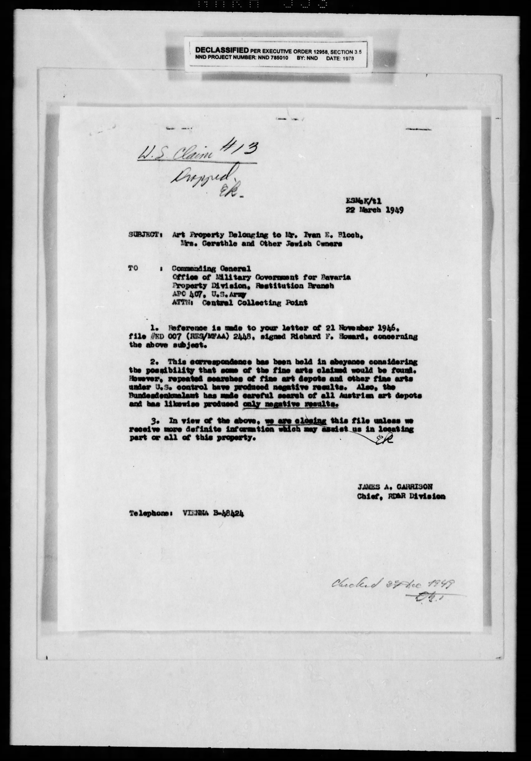
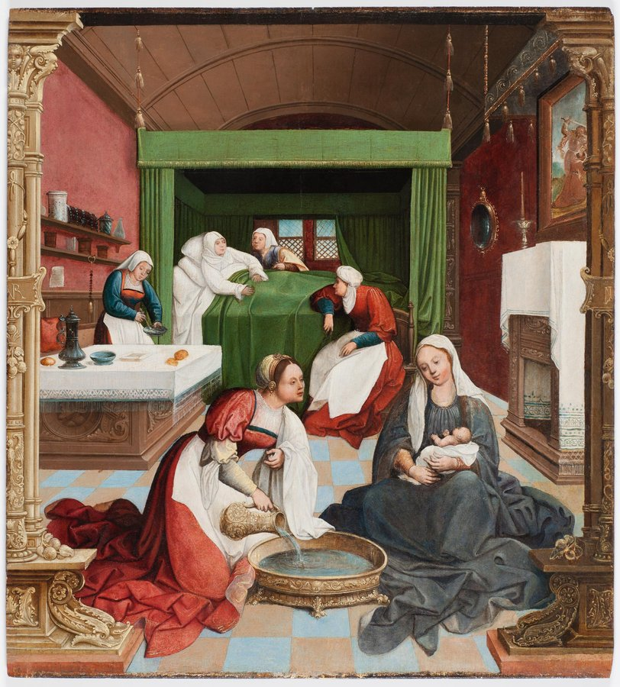
Why bother? Determine legal ownership

Slide 6
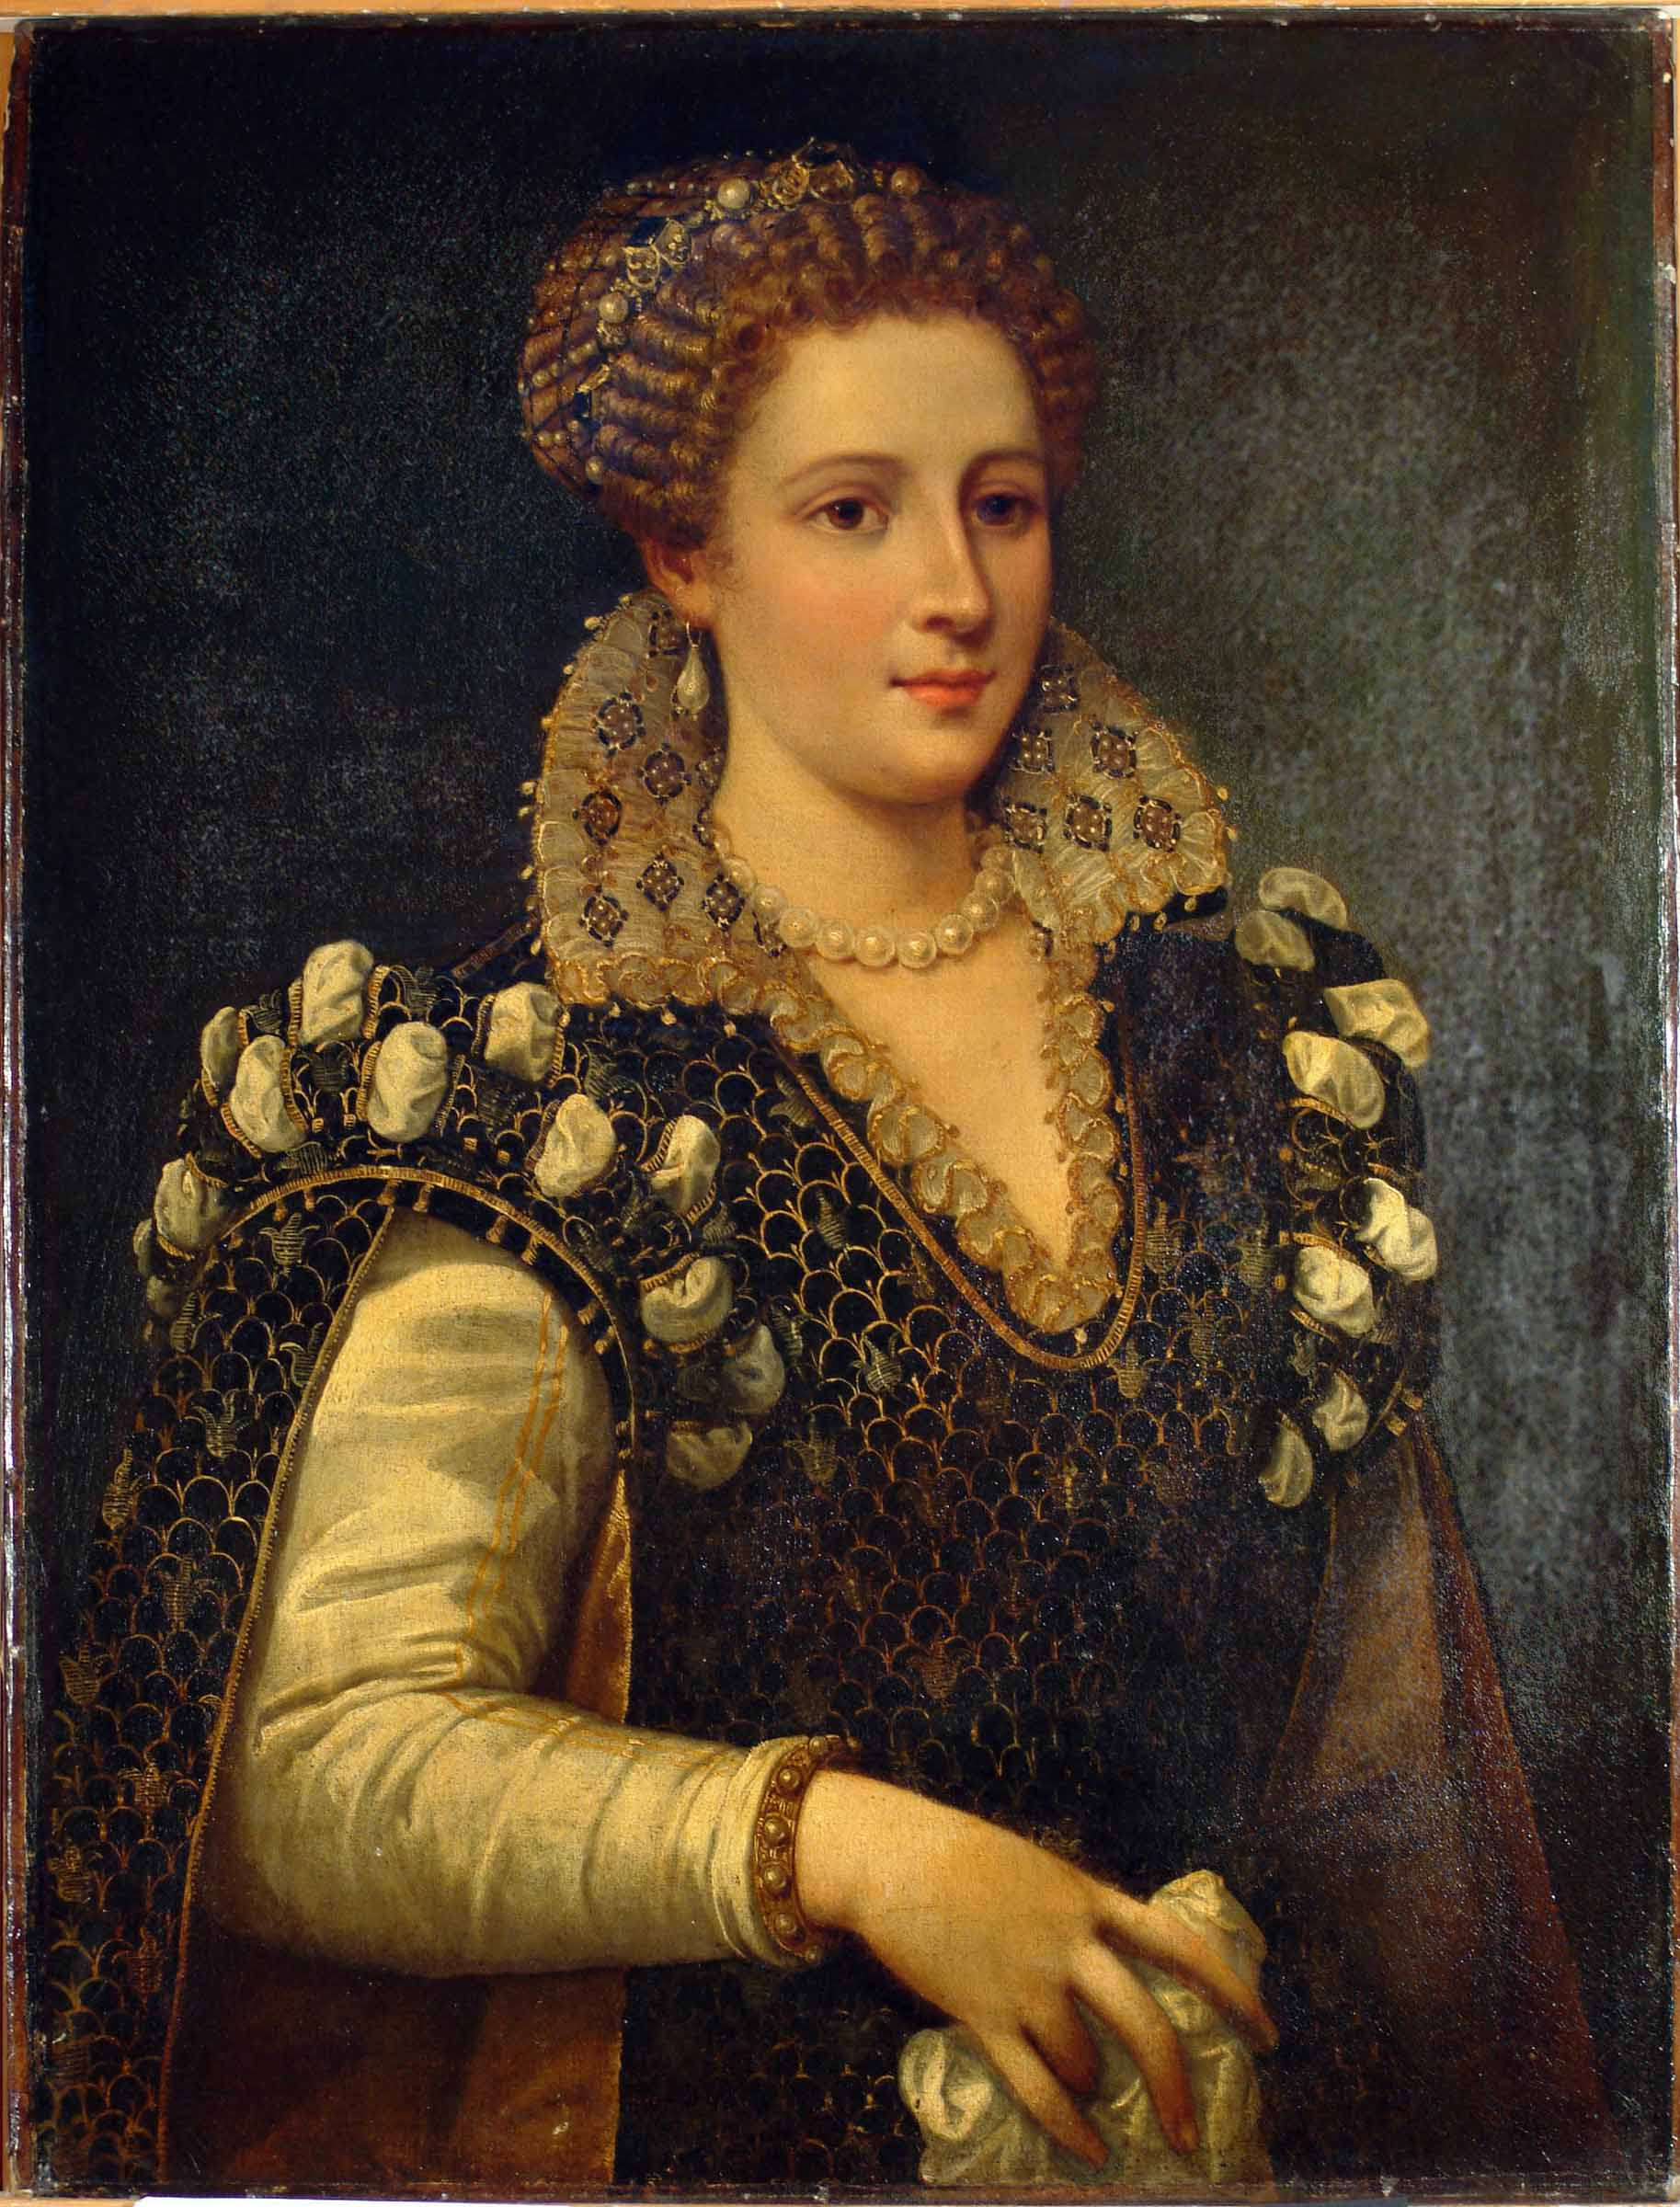
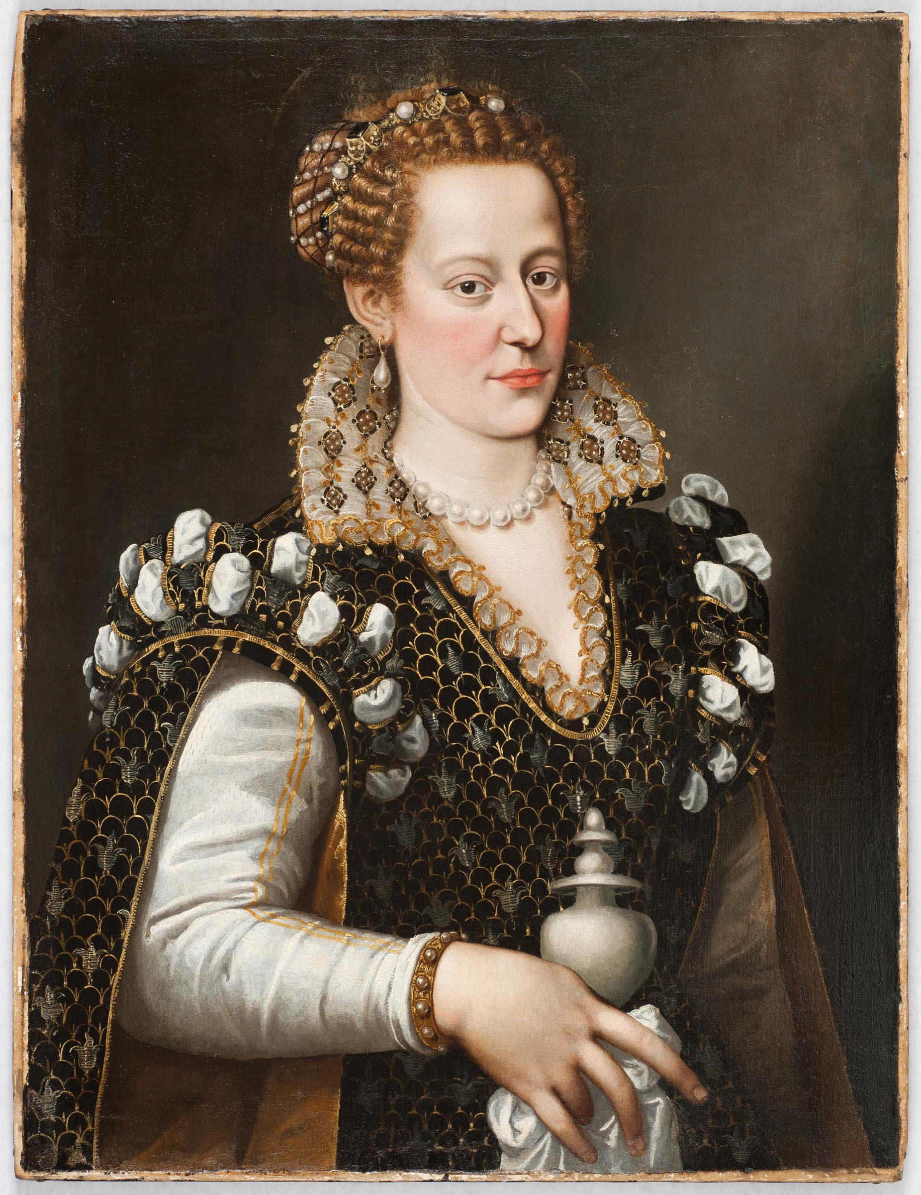
Why bother? Guide connoisseurship

Slide 7
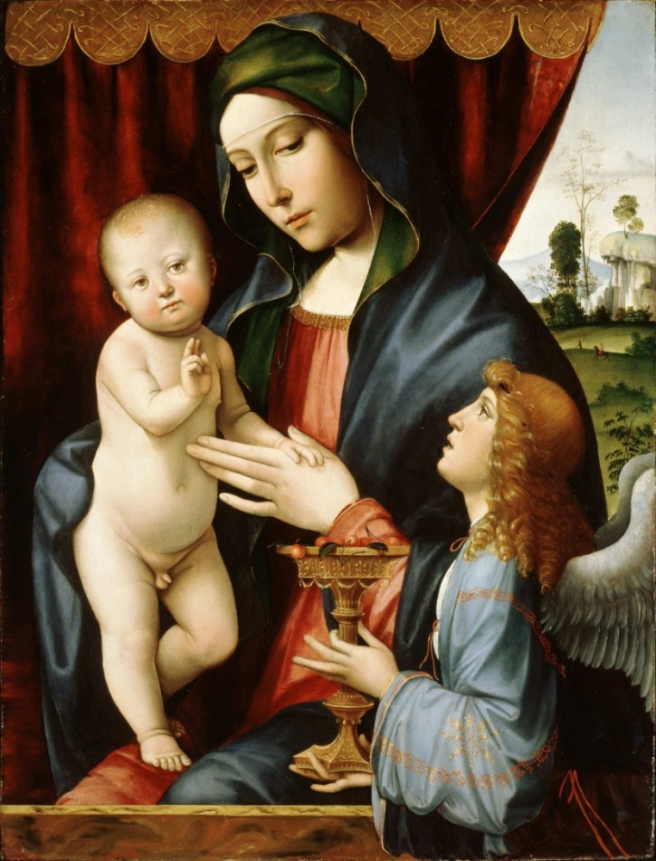
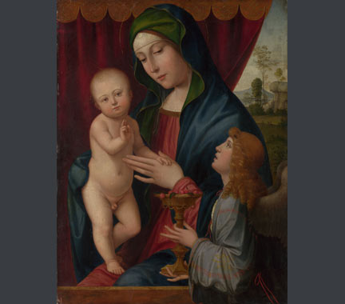
Why bother? Establish authenticity

Slide 8
Why bother? Authenticity

Slide 9
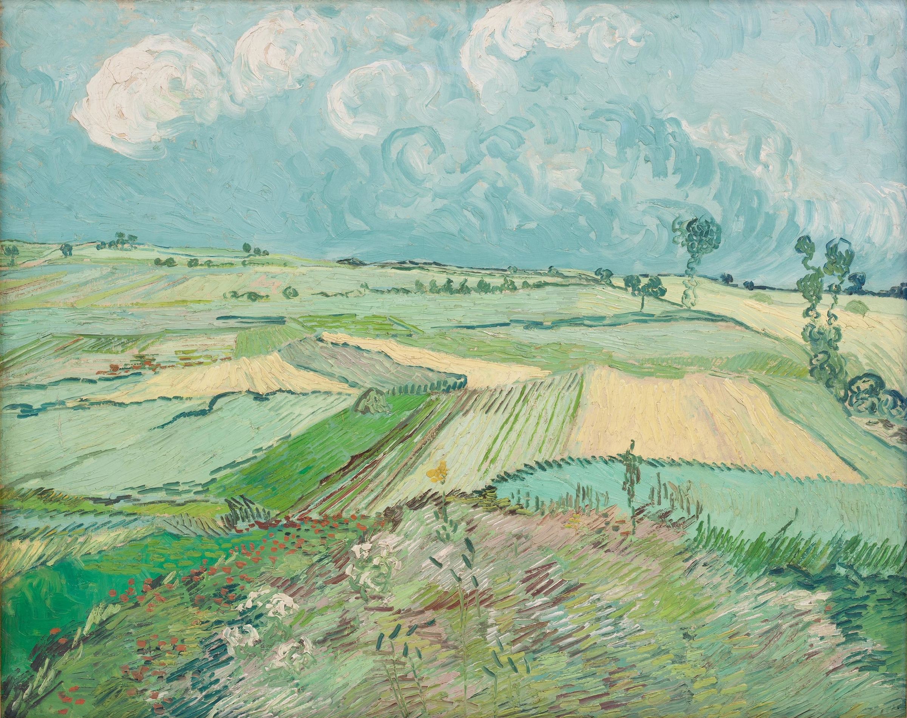
What can you do with it? catalogues
Vincent van Gogh [1853-1890]; Theo van Gogh; Johanna van Gogh-Bonger; V. W. van Gogh, Amsterdam, The Netherlands [1]; possibly Mme. Maria Slavona, Paris, France [2]; possibly Paul Cassirer Art Gallery, Berlin, Germany [2]; Harry Graf Kessler [1868-1937], Berlin, Germany and Weimar, Germany, by May 1901, probably 1897 to at least 1929, likely Fall 1931 [3]; Alex Reid and Lefevre Ltd, London, England [4]; Bignou Gallery, New York, NY, in March 1937 [5]; Mr. and Mrs. Marshall Field, New York, NY, possibly by October 1937 until November 1956 [6]; Mrs. Marshall Field (Ruth Pruyn Field) [c.1907-1994], New York, NY, until at least Summer 1966 [7]; Galerie Beyeler, Basel, Switzerland, by August 1968; purchased by Museum of Art, Carnegie Institute, Pittsburgh, PA, October 1968.
Notes:
[1]. Early provenance from Walter Feilchenfeldt, "Vincent van Gogh - The Years in France - Complete Paintings 1886-1890," English edition, published by Philip Wilson Publishers, 2013. The painting is no. 284 "Champs T.30" on the AB list (Andries Bonger list.)
[2]. Reference sources vary, but the Slavona and Cassirer provenance has not been established.
[3]. Kessler loaned the painting to the "Third Art Exhibition of the Berlin Secession," no. 68, "Flachlandschaft." The painting appears in a 1910 photograph of the library of Kessler's house in Weimar (see "Die Sammlung Harry Graf Kessler in Weimar und Berlin" by Sabine Walter in "Die Moderne Und Ihre Sammler," Akademie Verlag, Berlin, 2001, p.75 (copy from Frick Art Reference Library in curatorial file.)

Slide 10
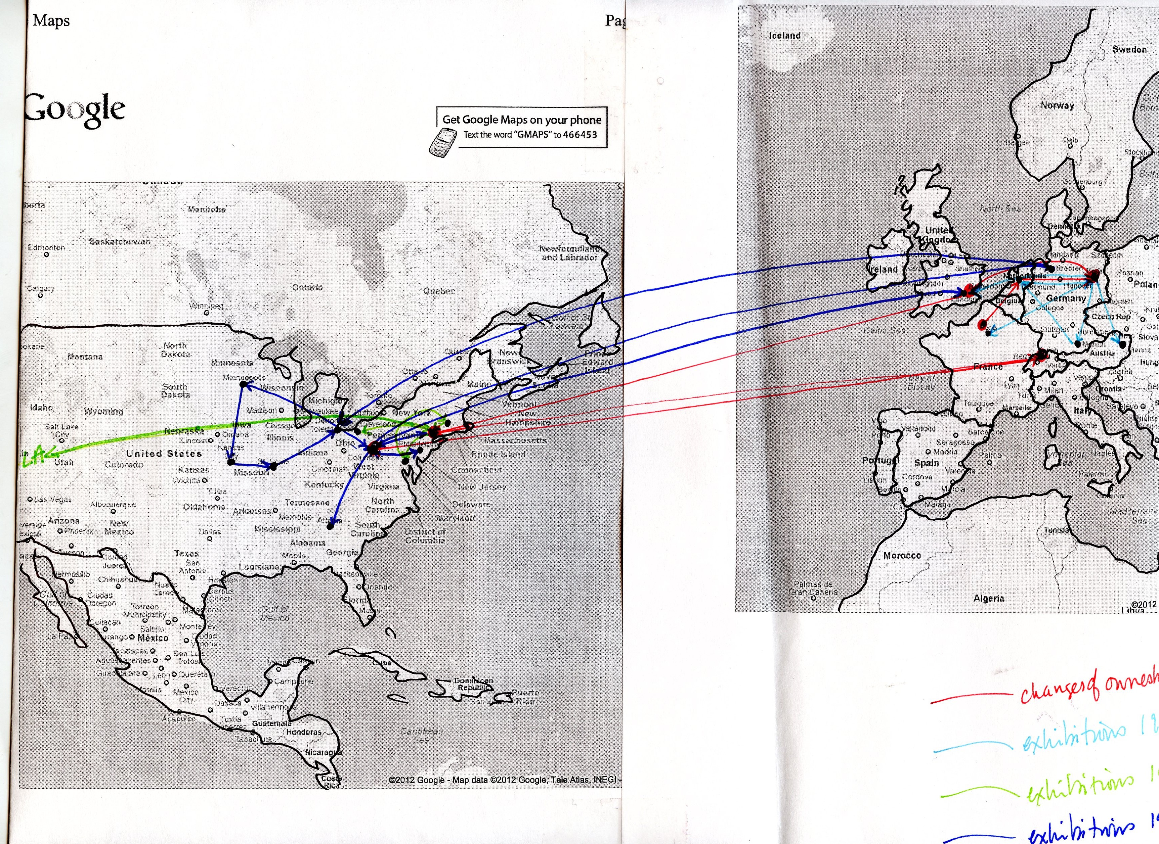
What can you do with it? stories

Slide 11
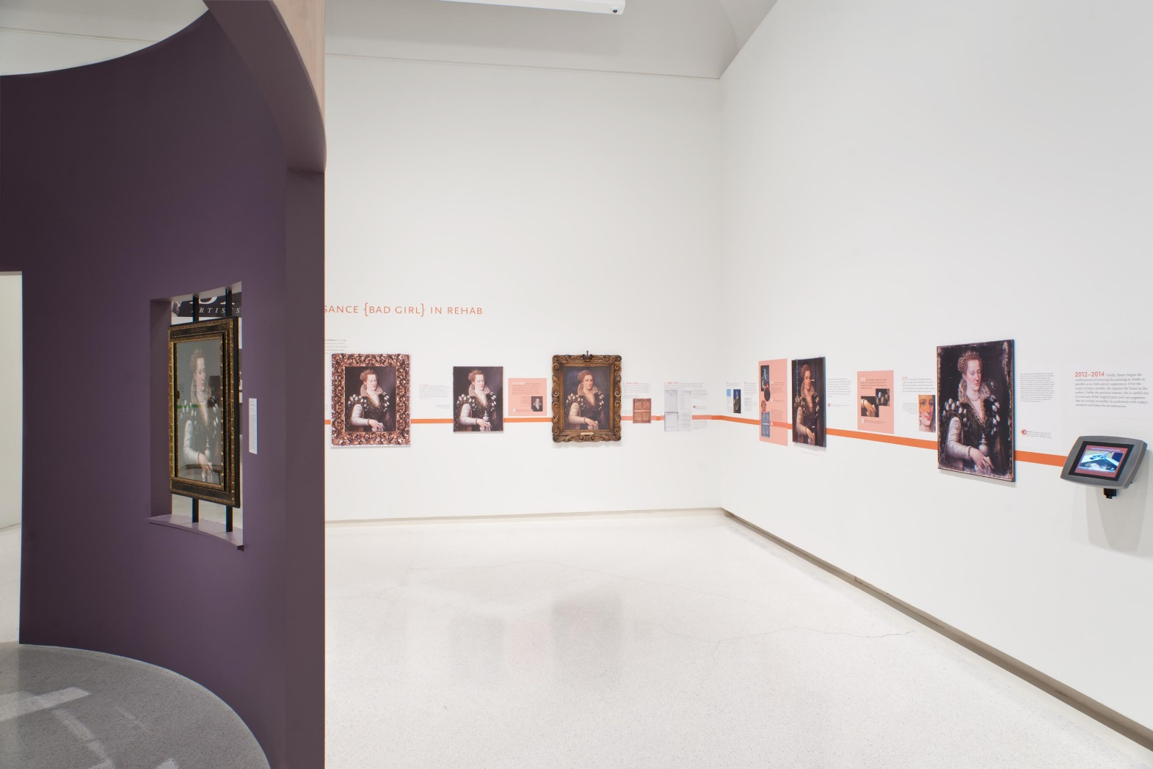
What can you do with it? exhibitions

Slide 12
The first meeting of quill pens & keyboards
Quill pens/curators
Keyboards/digital team
We have lots of data!
We guesstimate a lot!
Messy human behavior!
Paintings, books, documents!
Inches!
Years, decades, centuries!
Easy to do in my world!
Not possible in my world!
No you don’t!
We are ridiculously exact!
Humans?
Code!
Pixels and bytes!
Seconds, minutes, hours!
Really hard in my world!
Easy to solve in my world!

Slide 13
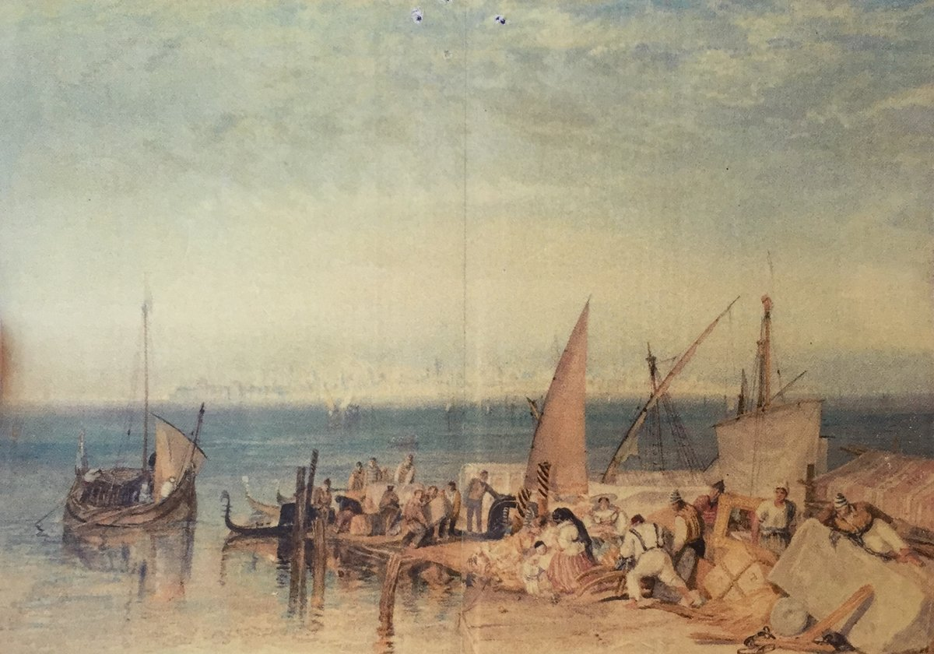
Art Tracks is about discovering and recording connections between works of art and people, places, and events through history.

Slide 14
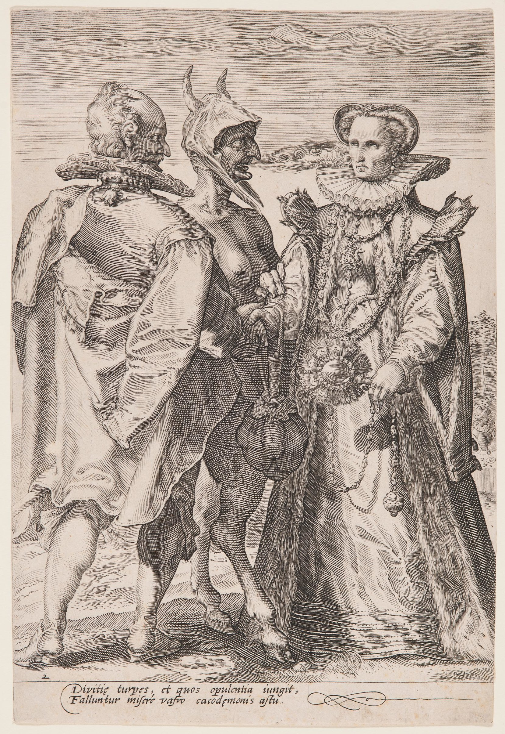
Art Tracks: thinking about marriage
Marriage in the human and digital worlds
Romantic love
Survival of the species
Preservation and transmission of property
Marriage of the human and digital worlds
Marriage of greed?
Pact with the devil?
Opposites attract?

Slide 15
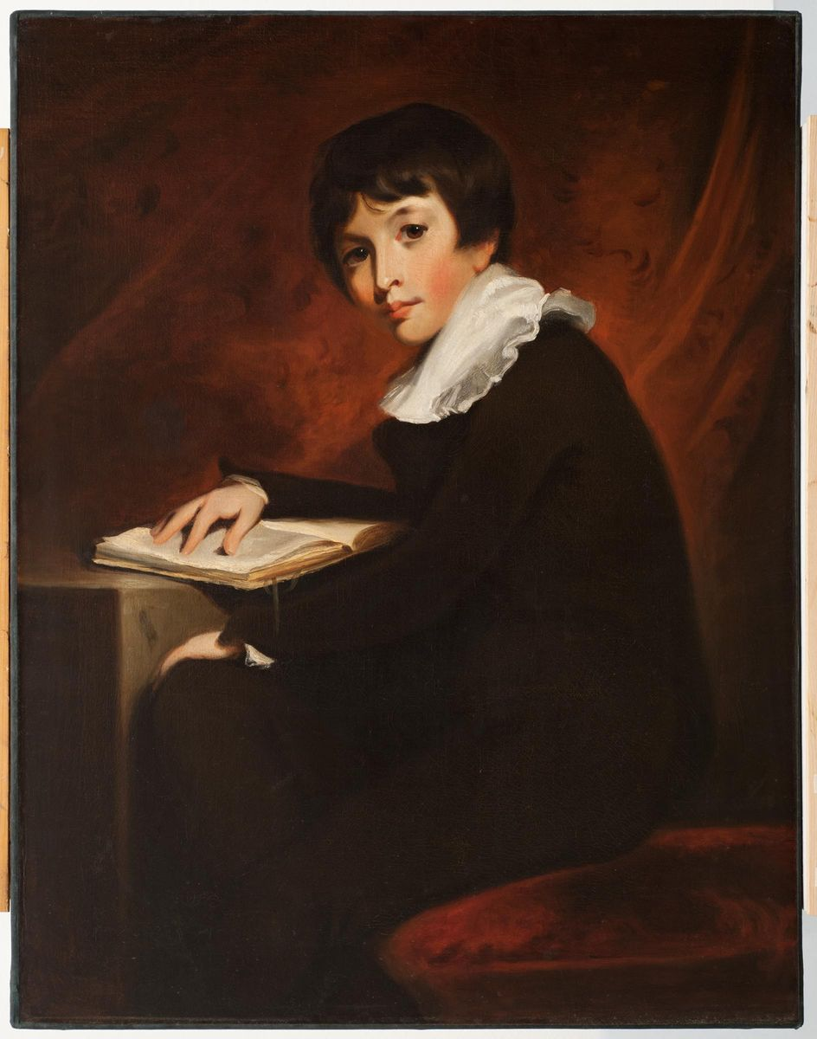
Art Tracks: Advancing scholarship
Create bigger data sets by standardizing and sharing data
Data mining and pattern detection
Visualizations
New questions

Slide 16
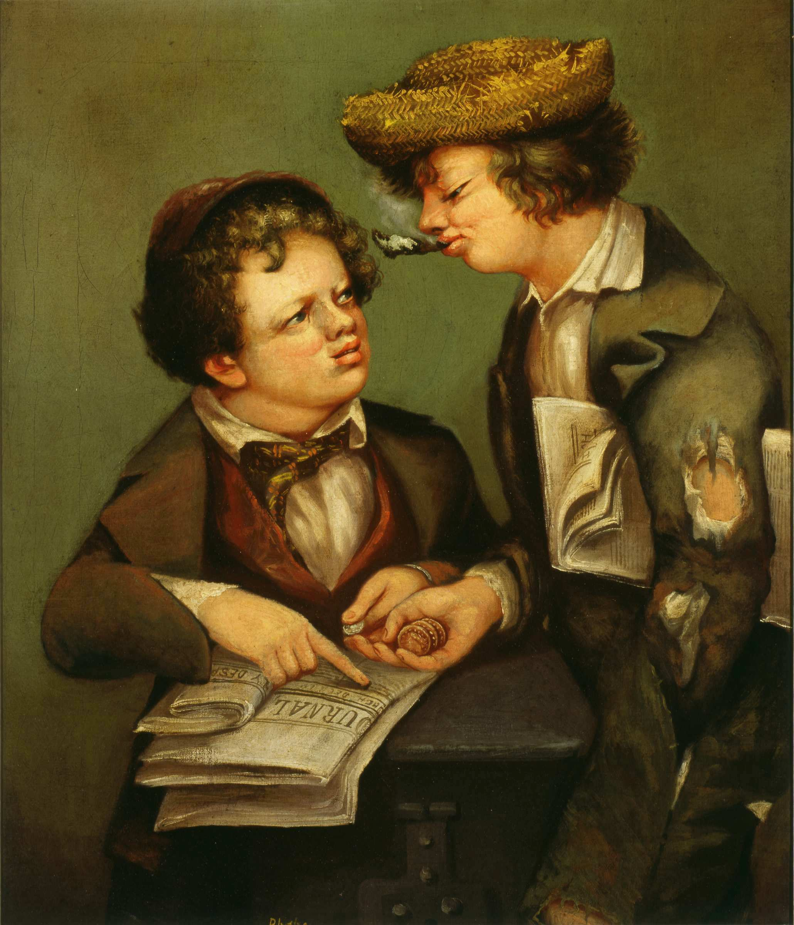
Art Tracks: Disrupting museums and art history
Objects become data; collections become databases
Multiple stories become possible
A digital enterprise erasing institutional & disciplinary boundaries

